Slide 1
Summer Internship Project Vocational Training

Slide 2
Vocational Training Presentation
Name – Saurabh Nirmalkar
Roll No. - 302910922023
Topic – Web Development
B.Tech / AIML / 5th Sem
VT Completed From Octanet Services Pvt. Ltd.
From 1st August 2024 to 1st September 2024

Slide 3
Technologies And Languages Title
A web page is a document or resource on the internet that is displayed in a web browser. It is written using HTML and can include text, images, videos, and links to other web pages. Web pages are the building blocks of websites, providing content and information for users to view and interact with online.
Front End-
HTML
HTML (HyperText Markup Language) is the core language for creating web pages. It structures the content on a webpage using elements like headings, paragraphs, images, and links. HTML works with other technologies like CSS for styling and JavaScript for interactivity, forming the foundation of most websites.

Slide 4
Technologies And Languages Title
CSS
CSS (Cascading Style Sheets) is a language used to style and design the layout of web pages. It controls the appearance of HTML elements, such as fonts, colors, spacing, and positioning, making web pages visually appealing and responsive across different devices.

Slide 5
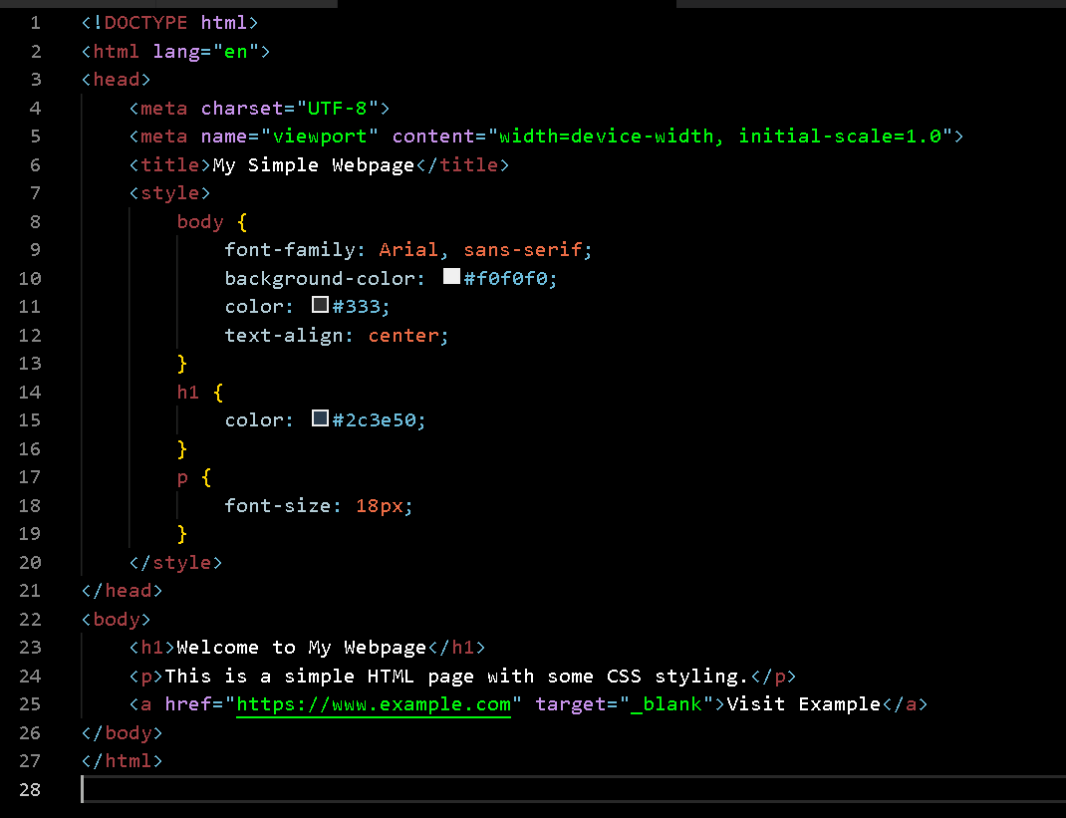
Screenshots

Slide 6
Purpose of our webpage
Our website is here to show off the beautiful photos we take and the different photography services we offer.
Whether it’s portraits, weddings, events, or commercial work, we want visitors to see our style and what we can do.
It’s also a place where you can easily look through our portfolio, learn more about us, and get in touch for bookings or questions.
Our goal is to make it easy for you to find the right photography service for your needs.
For booking we provide our contacts

Slide 7

Screenshots

Slide 8
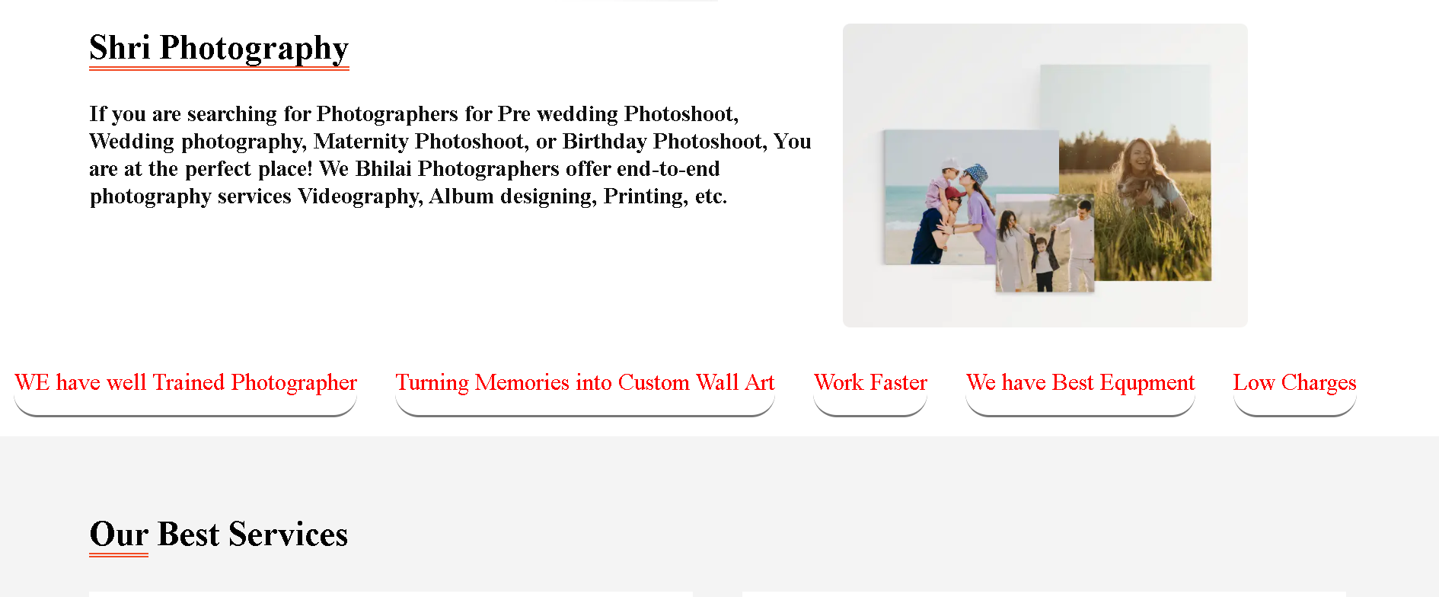
Screenshots

Slide 9
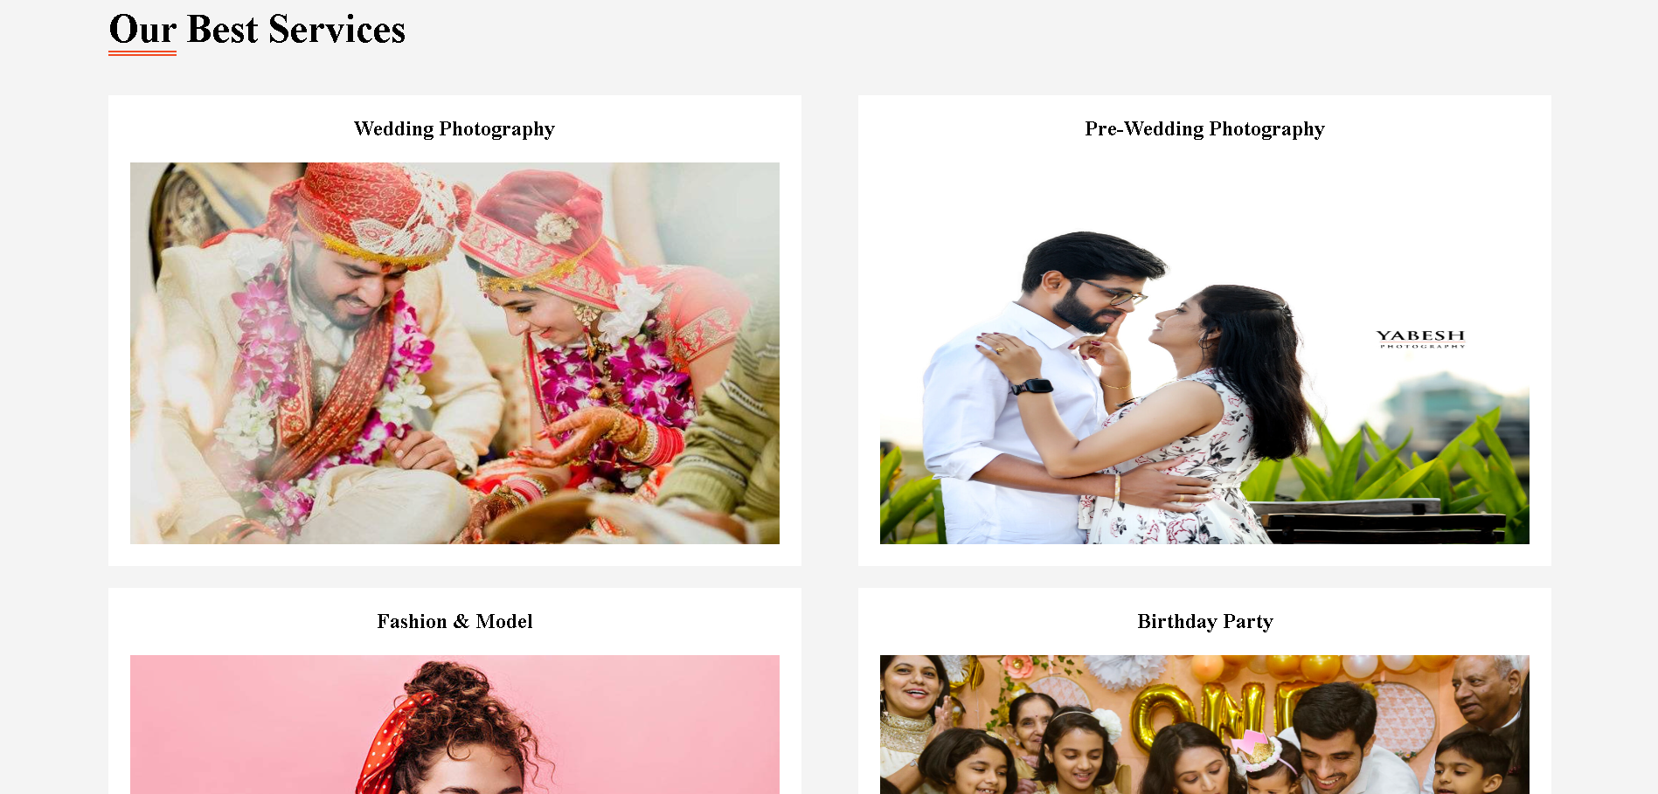
Screenshots

Slide 10
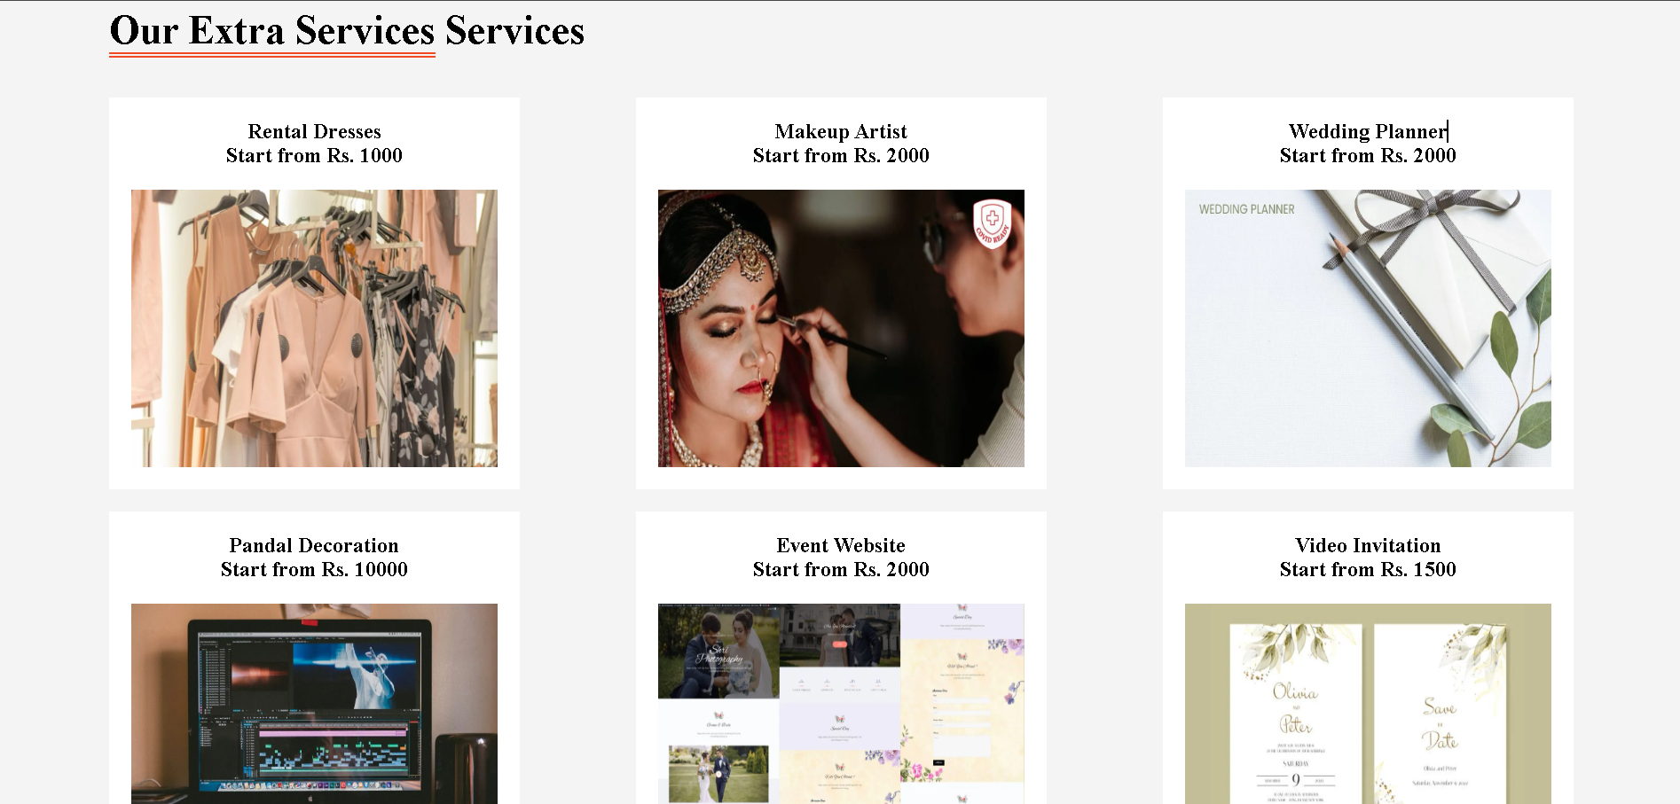
Screenshots

Slide 11
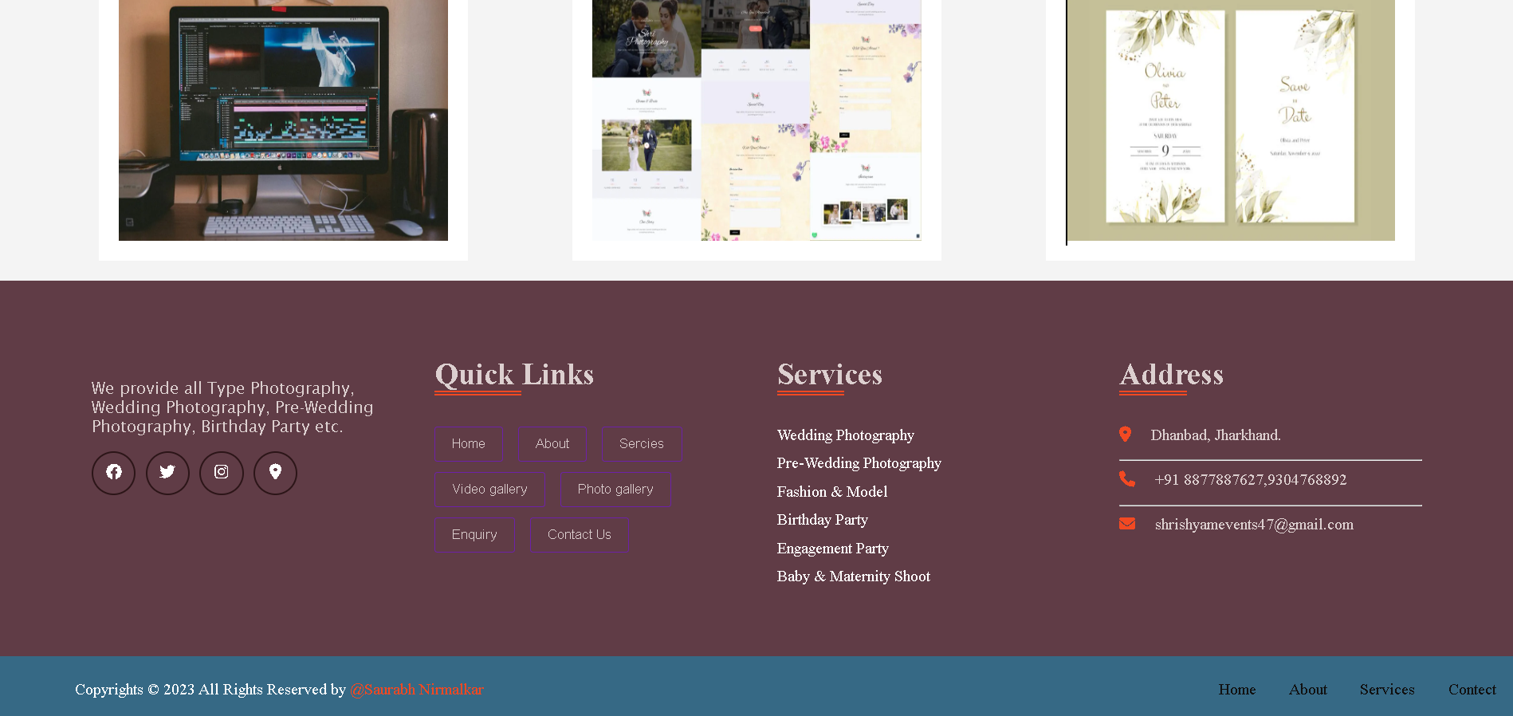
Screenshots

Slide 12
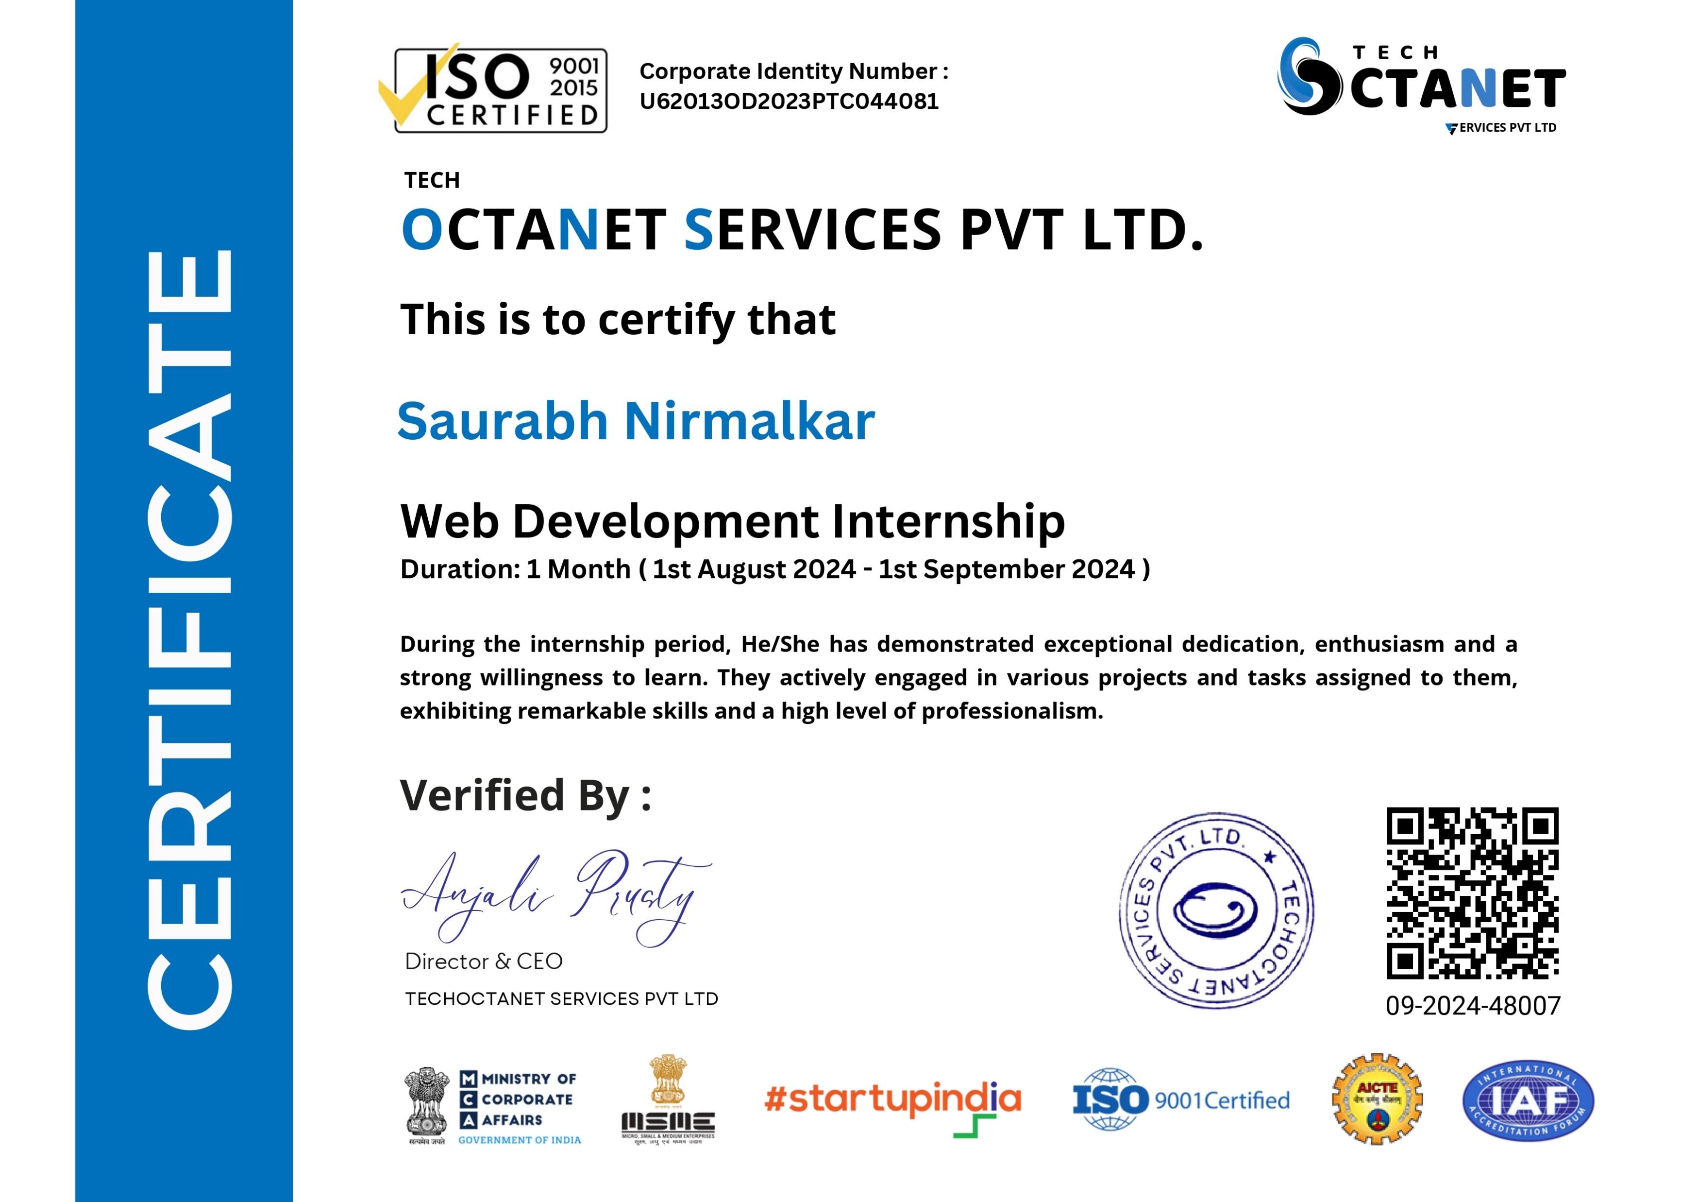
Certificate

Slide 13
Thank you

